Slide 1
AT&T Modification
1570 Alta La Jolla Dr
PTS-0684820

Slide 2
History
Originally approved in under NUP #258238 on October 12, 2006
Located as a complete concealed facility on the rooftop along with Verizon and T-Mobile
Applying to renew and modify entitlements

Slide 3
Zoning
Zone: RS-1-4
Zone Height: 24’
Fully concealed facility
Fully compliant with Section 141.0420 of SDMC

Slide 4
Scope of Work
Remove:
(6) antennas
(6) RRUs
Other ancillary equipment
Install:
(6) antennas
(9) RRUs
Upgraded mounts
Other ancillary equipment

Slide 5
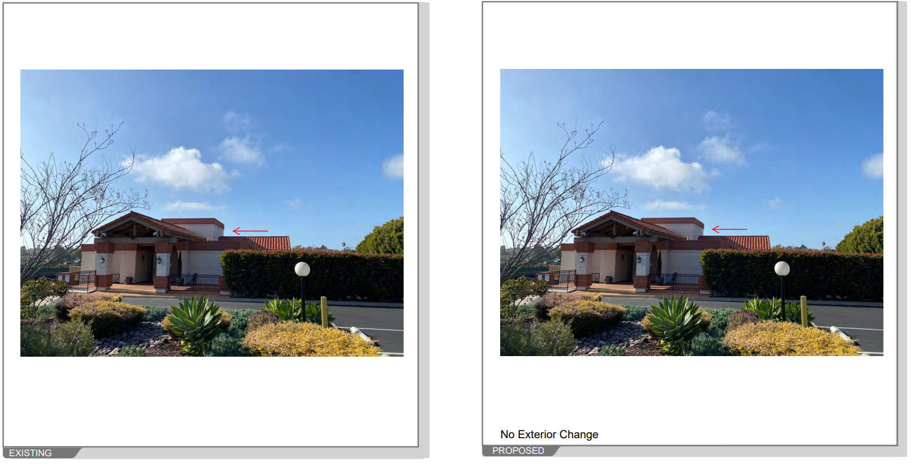

Slide 6
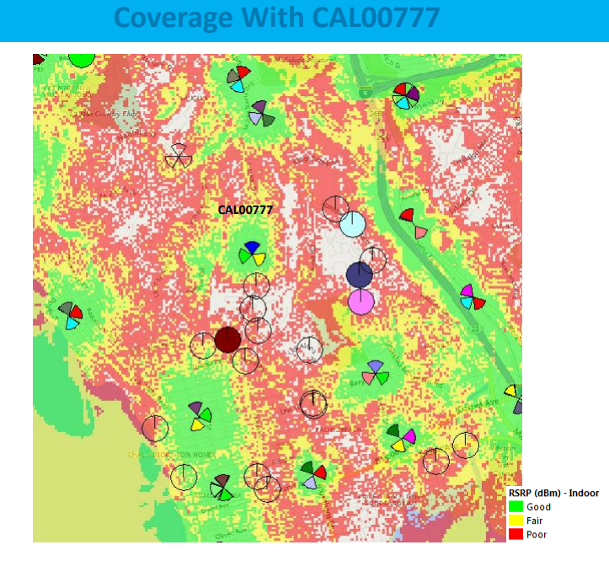

Slide 7
