Slide 1
Bentley CDP
Remodel and Addition
Project 694482
5655 La Jolla Hermosa Avenue

Slide 2
5655 La Jolla Hermosa Avenue, La Jolla, CA 92037
Project: Bentley CDP
Project Number 694482
Date: 14 December 2021
Presentation: LJCPA Development Permit Review Committee
Scope of Work:
Proposing to add to the existing front of the detached garage and build a new 2nd floor addition over the existing garage for an accessory dwelling unit, approx. 470 SF.
General Information:
Lot Size: 6,242 SF/0.1433 acre
Existing house: 1,726 SF 3 beds, 2 baths
Setbacks: Front 15’ 0” (established) & Rear 13’ 0”
Sides (E) 4’ 0” & 1’ 9” at garage
FAR max: 0.58 x 6,242 = 3,620.44 SF
Area totals: (E) SFR: 1,726 SF
(E) Garage: 362 SF
(N) Garage Add: 108 SF
(N) Companion Unit 470 SF

Slide 3
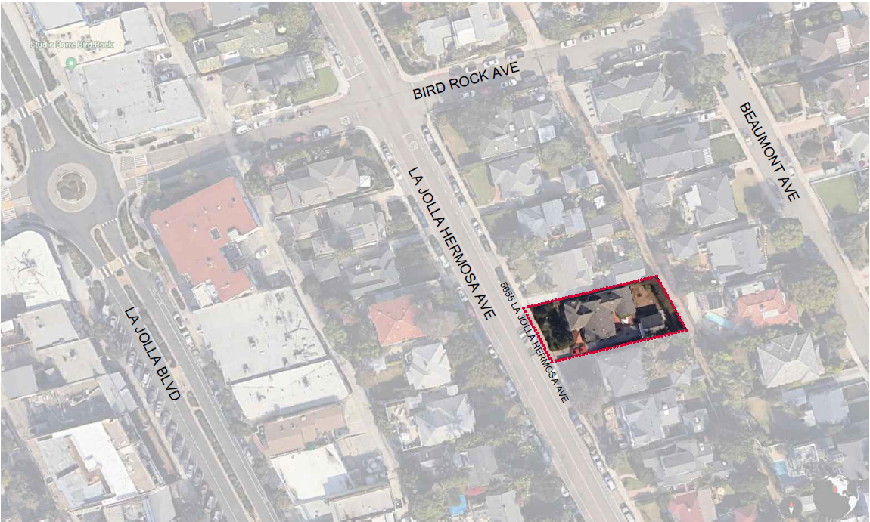
Bentley CDP
Location
5655 La Jolla Hermosa
Avenue

Slide 4
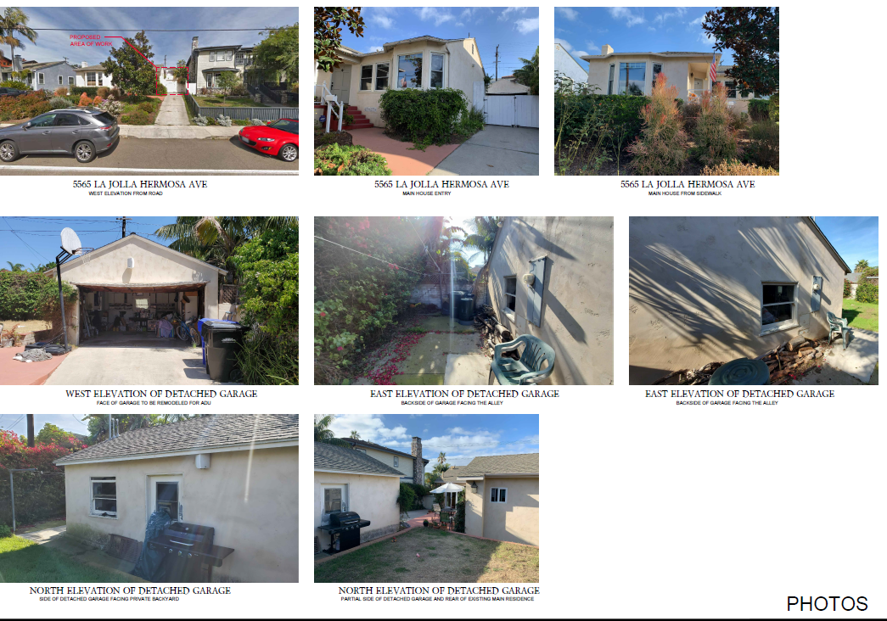
Bentley CDP
Photos
5655 La Jolla Hermosa Avenue

Slide 5
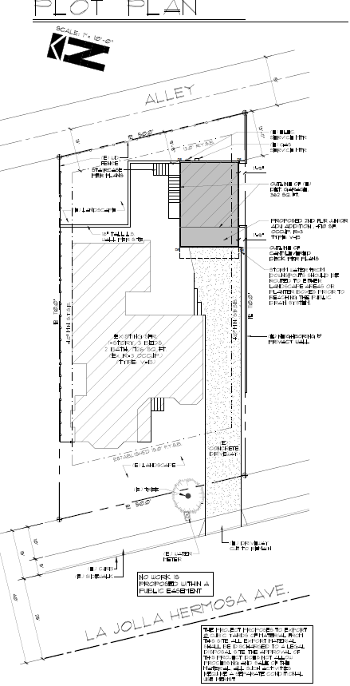
Bentley CDP
Plot Plan
5655 La Jolla Hermosa Avenue

Slide 6
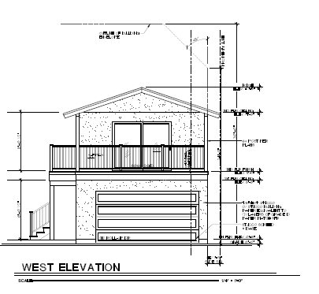
Bentley CDP
West Elevation
5655 La Jolla Hermosa Avenue

Slide 7
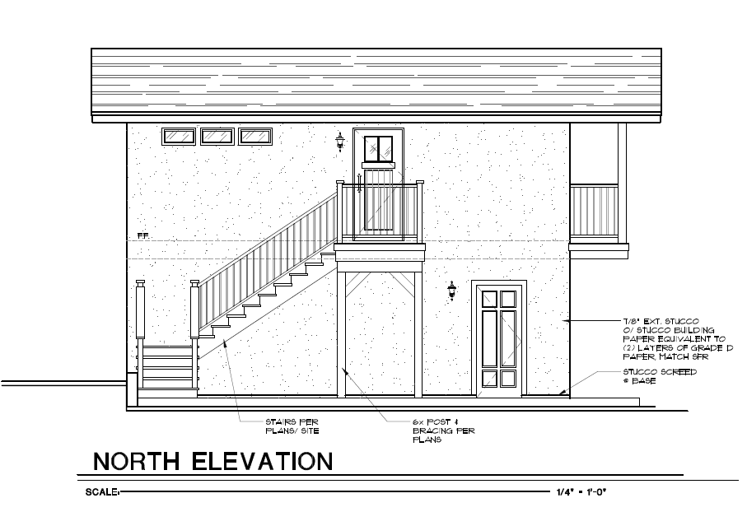
Bentley CDP
North Elevation
5655 La Jolla Hermosa Avenue

Slide 8
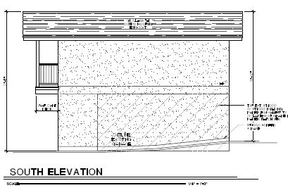
Bentley CDP
South Elevation
5655 Ls Jolla Hermosa Avenue

Slide 9
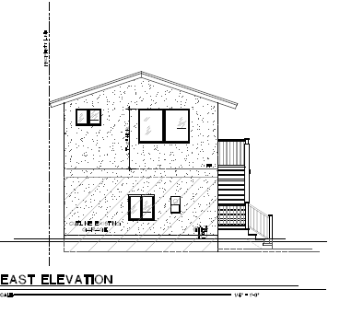
Bentley CDP
East Elevation
5655 La Jolla Hermosa Avenue

Slide 10
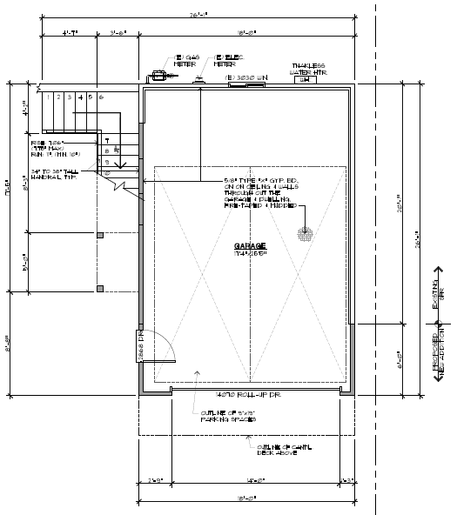
Bentley CDP
Proposed 1st Floor Plan
5655 La Jolla Hermosa Avenue

Slide 11
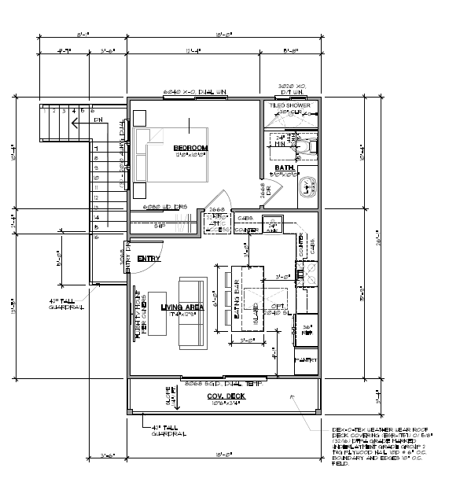
Bentley CDP
Proposed 2nd Floor Plan
5655 La Jolla Hermosa Avenue

