Slide 1
Alternate Option for La Jolla View Reservoir
RONALD A SCHACHAR, MD, PHD
4-FEB-2021

Slide 2
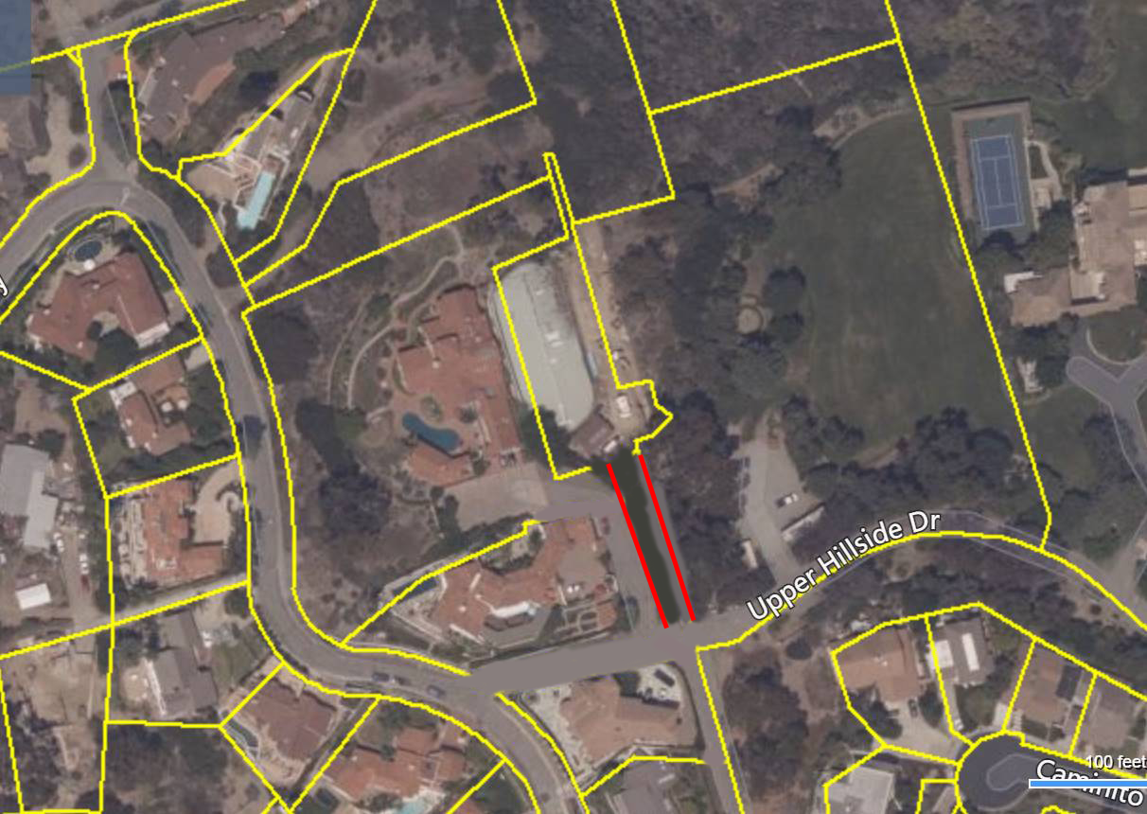
USE LA JOLLA COUNTRY CLUB RESERVOIR SITE
PLACE RESERVOIRS UNDERGROUND BELOW THE
ACCESS ROAD

Slide 3
3 UNDERGROUND RESERVOIRS
ACCESS ROAD
RESERVOIR
30’ DIAMETER 100’ DEEP
30’ DIAMETER BY 100’ DEEP = 528,462 MILLION GALLONS
5 ADJACENT RESERVIORS = 2,642,310 MILLION GALLONS
ALL PIPES PLACED BELOW EXISTING STREETS
RESERVOIR
30’ DIAMETER 100’ DEEP
RESERVOIR
30’ DIAMETER 100’ DEEP
~ 160 feet
RESERVOIR
30’ DIAMETER 100’ DEEP
RESERVOIR
30’ DIAMETER 100’ DEEP
~ 30 feet

Slide 4
ADVANTAGES
SITE HAS HAD ENVIRONMENTAL IMPACT REVIEW
HIGHER HYDROSTATIC PRESSURE
5 RESERVOIRS OFFER A SAFETY BACK UP
ALL PIPES BELOW EXISTING STREETS
OLD RESERVIORS REMOVED FROM LA JOLLA VIEW PARK
REMOVE TOWERS FROM LA JOLLA VIEW PARK
LA JOLLA VIEW PARK RETURNS TO NATRUAL BEAUTY
LESS EXPENSIVE
MAY TAKE LESS TIME

